Slide 1

Smart Stick for Visually Impaired to Detect & Navigate Obstacles
GAYATRI VIDYA PARISHAD COLLEGE FOR DEGREE AND PG COURSE(A)
(Affiliated to Andhra University | Accredited by NAAC with " B++" Grade | ISO 9001: 2015)
Visakhapatnam-530045.
Project by
K. Deva Akhil
PG212202027
MCA 4th Sem
Project Under Guidance of
Shri C.H.S.S. Rajesh Patnaik
Assistant Professor
Department of Computer Science

Slide 2
Contents
Introduction
Abstract
Existing System
Proposed System
Components
Flow Chart
Connection Diagram
Conclusion

Slide 3
Introduction
Visually Impaired People do lead a normal life with their own style of doing things. But, they definitely face troubles due to inaccessible infrastructure and social challenges. Let us have a look at the biggest challenge for a visually impaired person is to navigate around places. Obviously, blind people roam easily around their house without any help because they know the position of everything in the house but in outside of the house they need an assistance for navigating premises around them to detect obstacles.
The Smart Stick is used to assist visually impaired individuals to navigate their surroundings more safely and independently. The stick which is present in this project consists integration of Ultrasonic sensor, Infrared sensor, LDR sensor, and Emergency Push Button to Arduino Uno Board.

Slide 4
Obstacle Detection Range Table
Obstacle Type | Sensors Used | Actual Range of Detection | Range of Sensor | Alert Type
Small Object like Stones, Steps, etc. | Infrared | 12cm | 0 - 9cm | Buzzer (change in Frequency Ex:20)
Humans | Ultrasonic | 250cm/8feet | 10 - 20cm | Buzzer (change in Frequency Ex:50)
Large objects like Walls, Poles, trees, etc. | Ultrasonic | 250cm/8feet | 10 - 30cm | Buzzer (change in Frequency Ex:500)
Moving Objects like cars, motor vehicles, etc. | Ultrasonic | 360cm/10feet | 10 - 40cm | Buzzer (change in Frequency Ex:750)
Man Holes, Pot Holes, Darkness | LDR | Has to Dip | Has to Dip | Buzzer (change in Frequency Ex:150)

Slide 5
Abstract
The “Smart Stick for Visually Impaired to Detect & Navigate Obstacles” is an innovative device designed to assist blind individuals with navigating their surroundings more safely and independently. The device incorporates with different sensors to detect obstacles, stairs and drainage holes and it provide warnings through buzzer and also contains Emergency Push Button. overall, the smart stick is an excellent example of how technology can be used to improve the lives of individuals with disabilities.

Slide 6
Existing System
The existing system “Arduino based third eye for blind people" is prepared to provide help for the blind people to tackle the lack of eyesight vision sense. This device uses the Buzzer to alert the people about the upcoming obstacle in his/her path by using ultrasonic sensor. This helps the blind people only to identify the obstacle by detecting it.

Slide 7
Proposed System
The Proposed System “Smart Stick for Visually Impaired to Detect & Navigate Obstacles” provides a more extensive view of the user’s surroundings, making it easier to navigate unfamiliar environments. It’s ability is to detect darkness, stairs and drainage holes is particularly important since these hazards are not always detectable by traditional aids. Warning system that uses a buzzer sensor is to alert users about hazards in their path and the warnings gives different alert for different hazards.

Slide 8
Components Used
9V Battery
Connecting Wires
Electric Switch
White Cane
ESP 8266 Wi-Fi Module
Arduino Uno
Sensors | Actuators
Ultrasonic | Buzzer
Infrared
LDR

Slide 9
Arduino Uno
Arduino Uno is a microcontroller board based on the ATmega328P (datasheet). It contains everything needed to support the microcontroller; simply connect it to a computer with a USB cable or power it with a AC-to-DC adapter or battery to get started.
"Uno" means one in Italian and was chosen to mark the release of Arduino Software (IDE) 1.0. The Uno board and version 1.0 of Arduino Software (IDE) were the reference versions of Arduino, now evolved to newer releases. The Uno board is the first in a series of USB Arduino boards, and the reference model for the Arduino platform; for an extensive list of current, past or outdated boards see the Arduino index of boards.

Slide 10
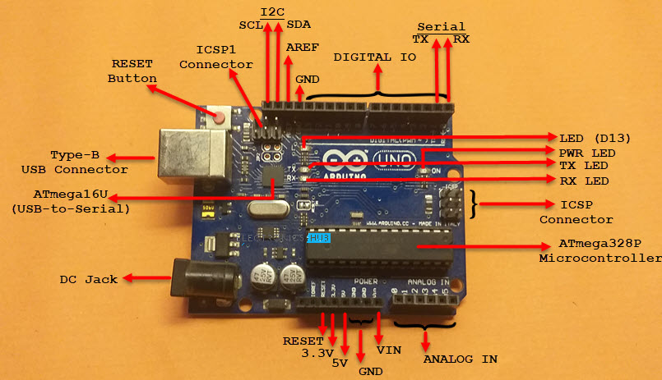
It has 14 digital input/output pins (of which 6 can be used as PWM outputs), 6 analog inputs, a 16 MHz ceramic resonator, a USB connection, a power jack, an ICSP header and a reset button.

Slide 11
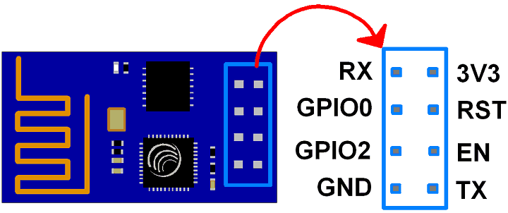
ESP Wi-Fi Module
The ESP8266 is a low-cost Wi-Fi microchip, with built-in TCP/IP networking software, and microcontroller capability, produced by Espressif Systems

Slide 12
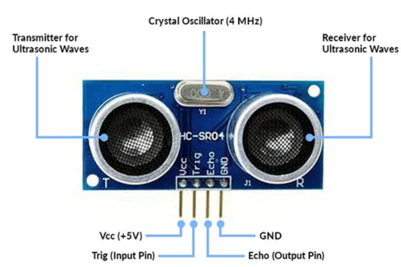
Ultra Sonic Sensor
The module has two eye like structure where one transmits a wave and the other receives it. This sensor is widely used for obstacle detection and also for measuring distances. The working frequency of the sensor is 40 Hz and the maximum range is 4m and min range is 2 cm.
This sensor consists of a 4 pin module. The pins are namely Vcc, Echo, Trigger and Ground. These 4 pins are connected to NodeMCU.

Slide 13
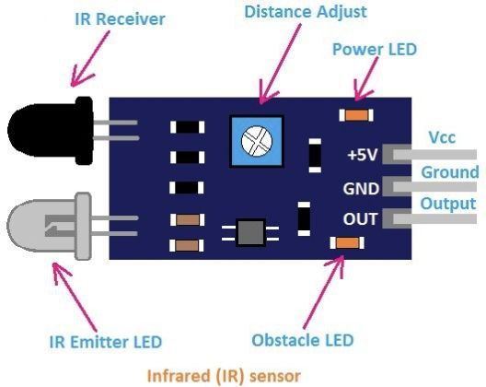
IR Sensor
IR Sensor functioning is also same as that of the Ultrasonic sensor since it also detects the obstacles. But the range is only 10-12 cm so it is used here for detecting very small distance obstacle.
The white LED here is an IR LED which works as the transmitter.
The component next to the IR LED is a photodiode that works as the receiver in the IR sensor.
IR Sensor contains 3 pins, there are
1.VCC
2.GND
3.OUT

Slide 14
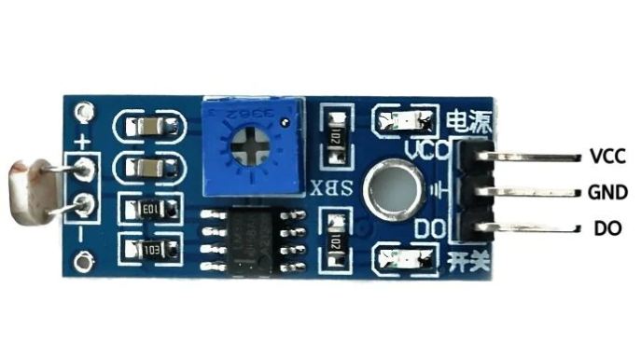
LDR Sensor
Light dependent resistor is a 3 pin module. This sensor has sensitivity to the light and it gives a high output as soon as the darkness is observed and vice versa.

Slide 15
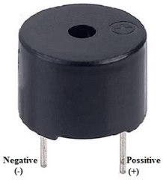
Buzzer
The Buzzer is a device that produces sound when an electric current is passed through it, The pin configuration of the buzzer is shown below.
1.Positive terminal of the Buzzer is represented with the ‘+’ symbol or longer terminal and it is connected to the I/O Pin.
2.Negative terminal of the Buzzer is represented with the ‘-’ symbol or short terminal and it is connected to the GND terminal.

Slide 16
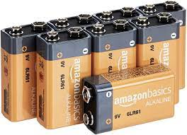
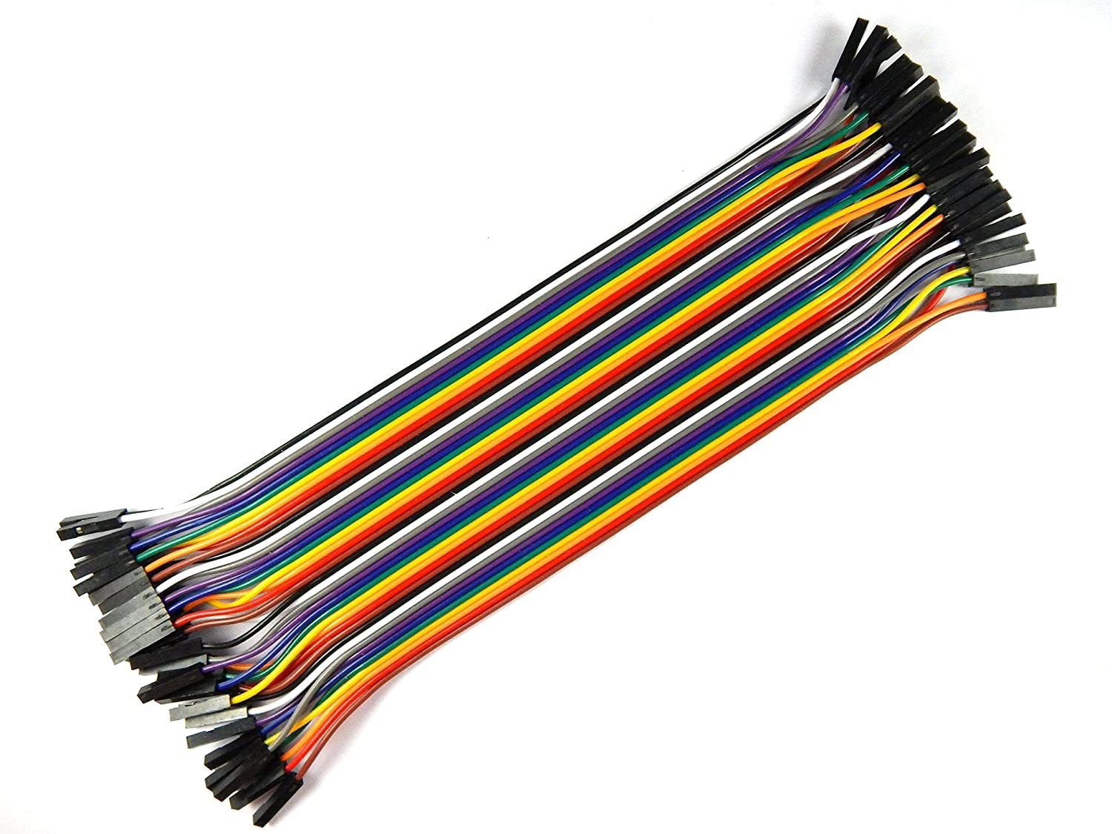
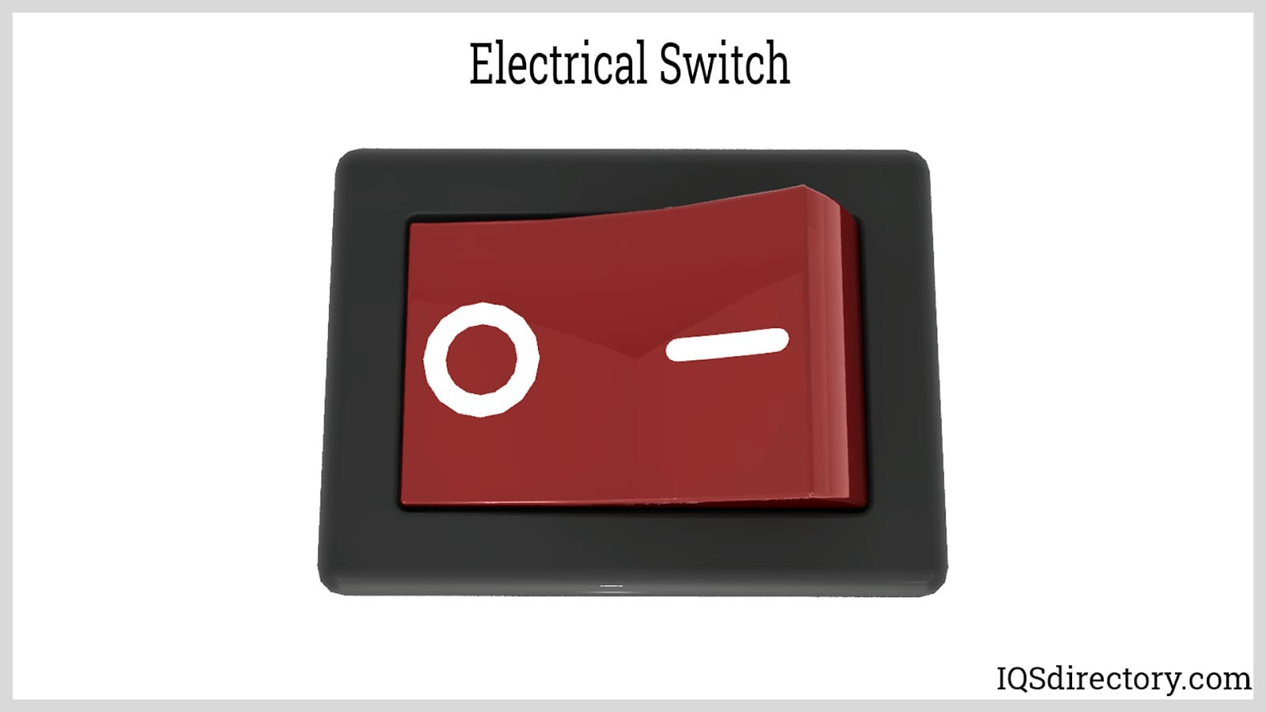
9V Battery, Connecting Wires, Electric Switch
A battery is a device that stores chemical energy, and converts it to electricity.
Wire is used to allow current to flow from one place to another.
An electric switch is an electrical component that breaks or closes an electric circuit.

Slide 17
Flow Chart
Start
Boot the System
Process the Sensor Values
If Push Button Pressed
If Pit holes Detected
If Object Detected
NO
YES
NO
YES
NO
YES
Sends Geolocation to Family using Cloud
Buzzer ON
Stop

Slide 18
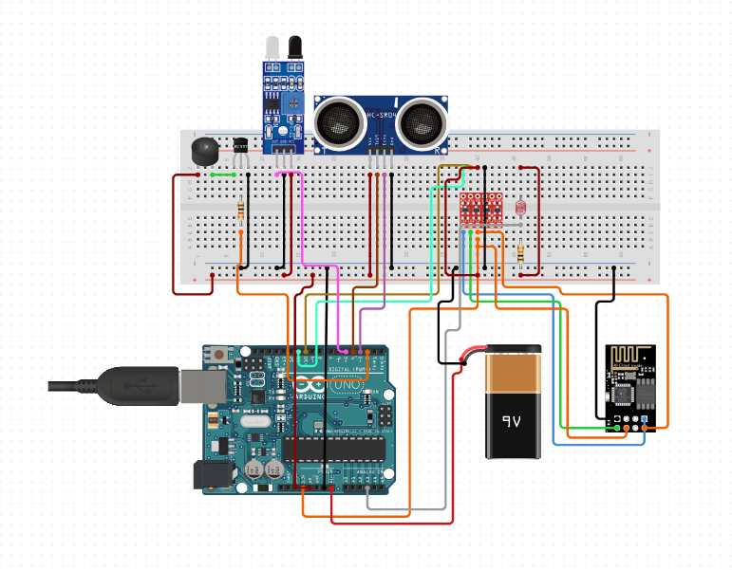
Connection Diagram

Slide 19
Conclusion
In summary, the smart stick is a helpful tool that can make lives easier and safer for blind people. It has sensors and warning systems that help detect obstacles and other hazards, making it a better option than a white cane. By using IoT technology to overcome some of the difficulties that people with disabilities face, the smart stick is a step towards a more inclusive and accessible world.

Slide 20

THANK YOU

Slide 21
Smart Stick for Visually Impaired to Detect & Navigate Obstacles
GAYATRI VIDYA PARISHAD COLLEGE FOR DEGREE AND PG COURSE(A)
(Affiliated to Andhra University | Accredited by NAAC with " B++" Grade | ISO 9001: 2015)
Visakhapatnam-530045.
Department of Computer Application
Project by
K. Deva Akhil
PG212202027
MCA 4th Sem
Project Under Guidance of
Shri C.H.S.S. Rajesh Patnaik
Assistant Professor
Department of Computer Application

Slide 22
Contents
Abstract
Requirement Analysis
System Requirements
UML Diagrams
Conclusion
Functional Requirements
Non - Functional Requirements
Software Requirements
Hardware Requirements
Use Case Diagram
Sequence Diagram
State Chart Diagram

Slide 23
Abstract
The “Smart Stick for Visually Impaired to Detect & Navigate Obstacles” is an innovative device designed to assist blind individuals with navigating their surroundings more safely and independently. The device incorporates with different sensors to detect obstacles, stairs and drainage holes and it provide warnings through buzzer and also contains Emergency Push Button. overall, the smart stick is an excellent example of how technology can be used to improve the lives of individuals with disabilities.

Slide 24
Requirement Analysis
Functional Requirements
Navigation assistance: The smart stick provide navigation assistance to the user by giving real-time information about obstacles.
Object detection: The stick is able to detect nearby objects such as walls, furniture, and other obstacles to prevent collisions.
Emergency assistance: The smart stick Contains a panic button that the user can press in case of an emergency, which sends a signal to a designated family member.

Slide 25
Requirement Analysis
Non Functional Requirements
Reliability: The smart stick is reliable and function correctly at all times to ensure the user's safety.
Usability: The smart stick is easy to use.
Battery life: The smart stick have a long battery life.
Maintainability: The smart stick is easy to maintain and repair, with a modular and easily replaceable design.
Scalability: The smart stick is able to upgrade or downgrade easily for changes demanded by user.

Slide 26
System Requirements
Software Requirements
Hardware Requirements
Operating System : Windows 7 and Above
Coding language : C++
Framework : Arduino IDE
Cloud : IFTTT
Arduino Uno Micro Controller
Ultra Sonic Sensor
Infrared Sensor
LDR Sensor

Slide 27
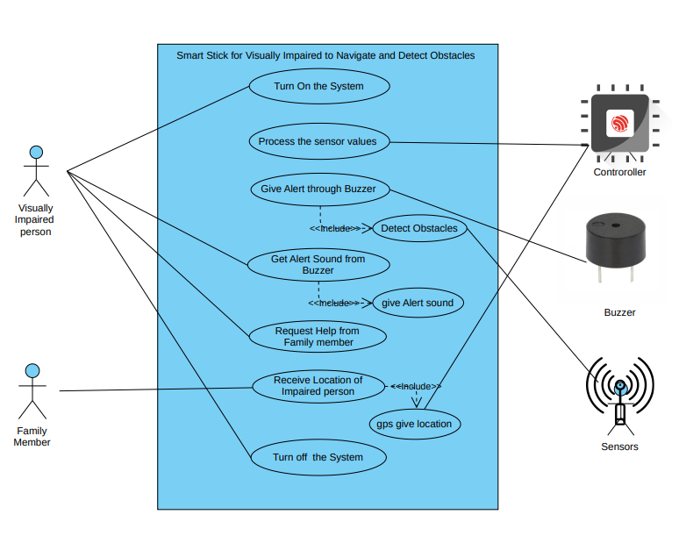
Use Case Diagram

Slide 28
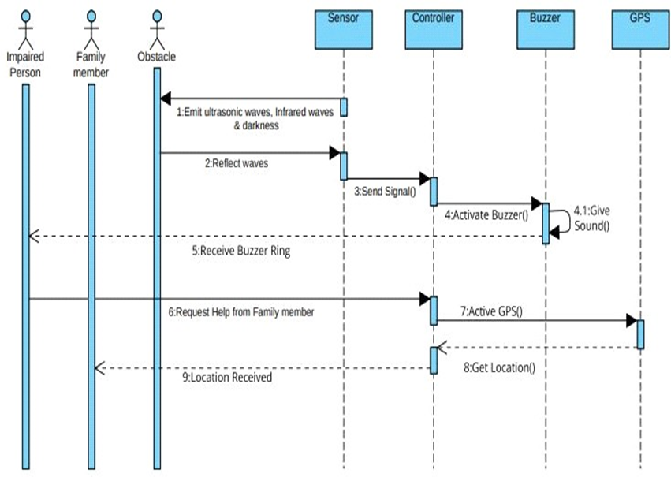
Sequence Diagram

Slide 29
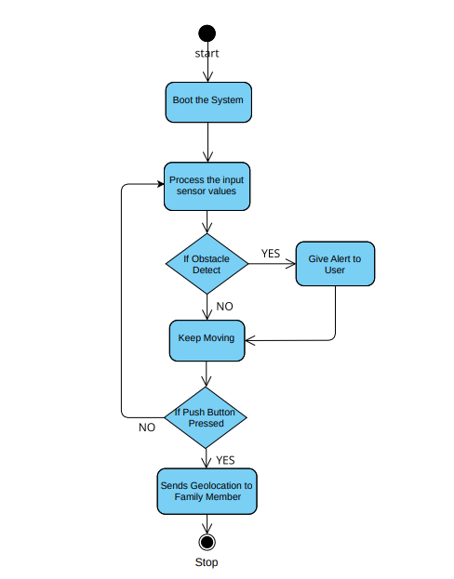
State Chart Diagram

Slide 30
Conclusion
In summary, the smart stick is a helpful tool that can make lives easier and safer for blind people. By using IoT technology to overcome some of the difficulties that people with disabilities face, the smart stick is a step towards a more inclusive and accessible world.

Slide 31
THANK YOU

